Slide 1
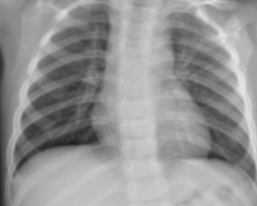

Meral Balik May 23, 2020
CNN For Detecting Pneumonia from X-ray Images

Slide 2
Contents
Problem Statement
Dataset
Data acquisition using google colab
Data inspection and visualization
Data preprocessing
Application of CNN
Baseline model
Compiling the model
Training the model
Evaluating accuracy and loss for the model
Model performance
Summary of Results and Follow-on Work

Slide 3
Problem Statement
Globally, 450 million get infected by pneumonia in a year
4 million people die from the disease in the world
50 thousand people die from the disease in the United States of America
Analyzing and classifying chest x-rays can be very tedious for radiologists
Artificial intelligence-based solutions can provide support for experts in the medical domain in performing time-consuming works

Slide 4
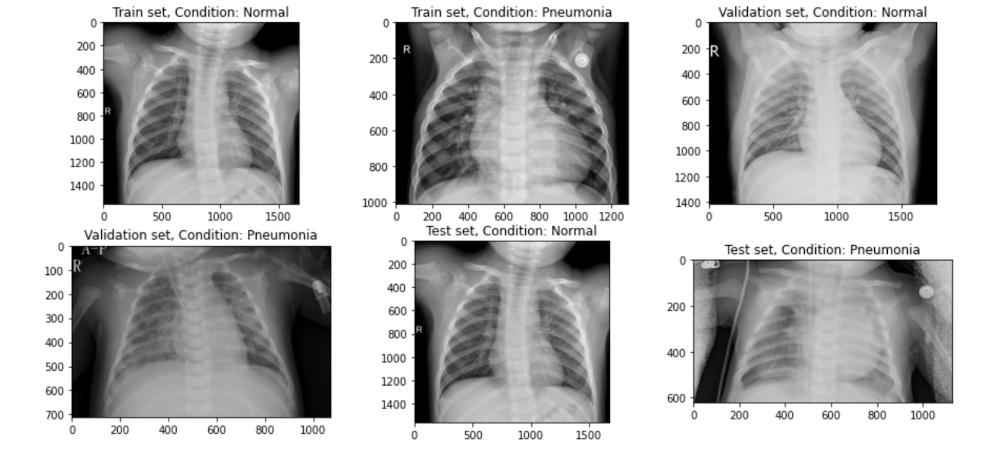
Dataset

Slide 5
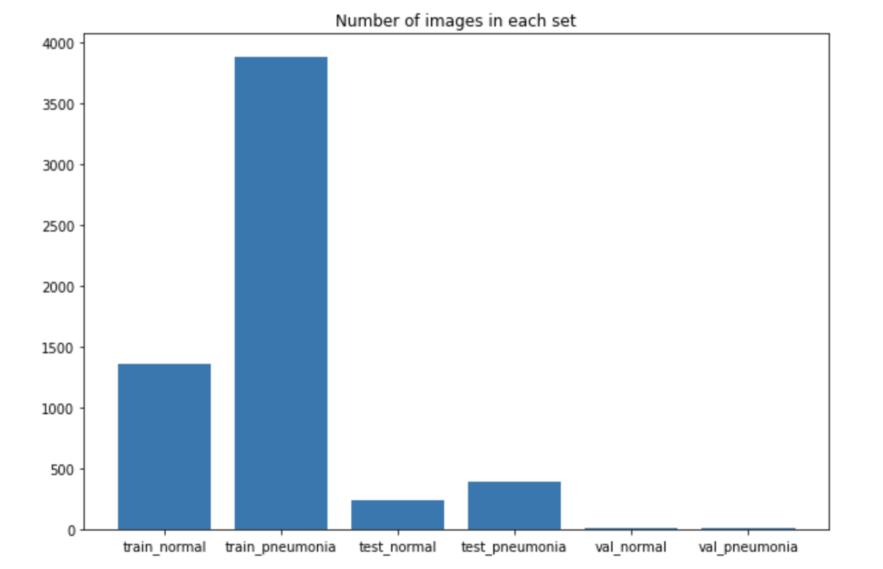
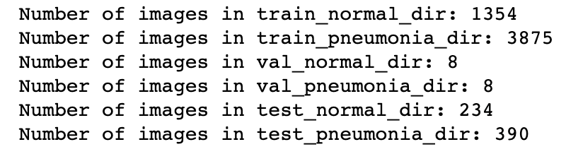
Dataset
https://www.kaggle.com/paultimothymooney/chest-xray-pneumonia
Organized into 3 folders (train, test, val)
5,863 X-Ray images (JPEG) and 2 categories (Pneumonia / Normal)
Figure 1. Number of images in each set

Slide 6
Data Acquisition Using Colab
Keras
High level library for building deep learning models
Tensorflow framework backend
Leverage backend engine to compute on GPU
Google Colab
Jupyter notebook environment running Python in Cloud
Access to GPU resources
Free

Slide 7
Data Preprocessing
ImageDataGenerator
reads images from disk and convert them to float32 tensors and feed them to the network
sets up generators that are capable of loading the required amount of data directly from the source folder, converting them into training data
rescales the images
performs data augmentation
zoom_range =0.3 and vertical_flip = True
flow_from_directory
load images from the disk, applies rescaling, and resizes the images into the required dimensions.

Slide 8
Application of CNN
Input
ImageDataGenerator
Convolutional Base
Four convolutional layers
Max Pooling – downsampling
Batch normalization – speed up training
Learns patterns at different scales
Dense Classifier
Four dense layers
Dropout layers – prevent overfitting
Sigmoid – binary classification problem

Slide 9
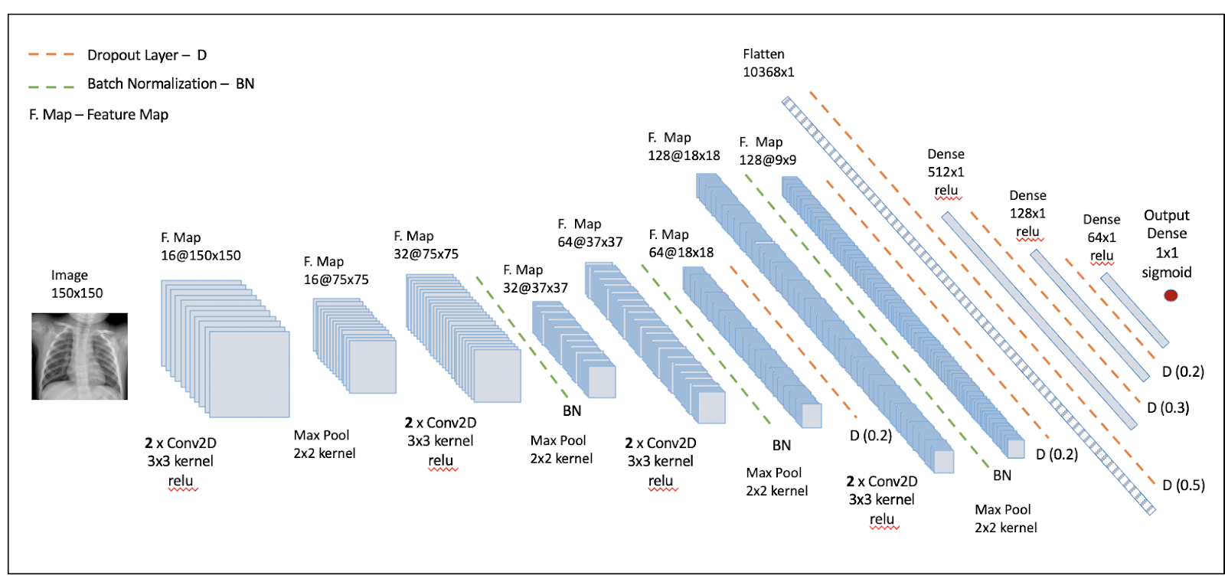
Baseline Model
Figure 2. Baseline Model

Slide 10
Compiling the Model
Loss Function | Optimizer | Output Metrics
How performance is measured on training data | How network parameters are updated during training | What measures to record during training
Binary – cross entropy ( two classes – ‘normal’ and ‘pneumonia’) | Adam - automatically adapts the learning rate during training | Accuracy

Slide 11
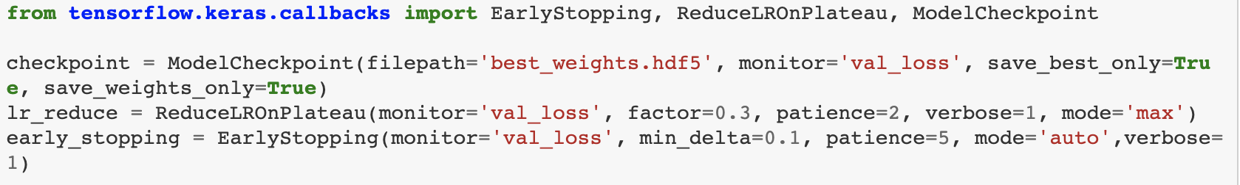
Training the Model
Callback Functions
ModelCheckpoint | ReduceLROnPlateau | EarlyStopping
Saves model or weights at some intervals so the model or weights can be loaded later to continue the training. | Monitors a quantity and if no improvement is seen for a 'patience' number of epochs, the learning rate is reduced. | Prevents overtraining of the model by terminating the training process if it’s not really learning anything.

Slide 12
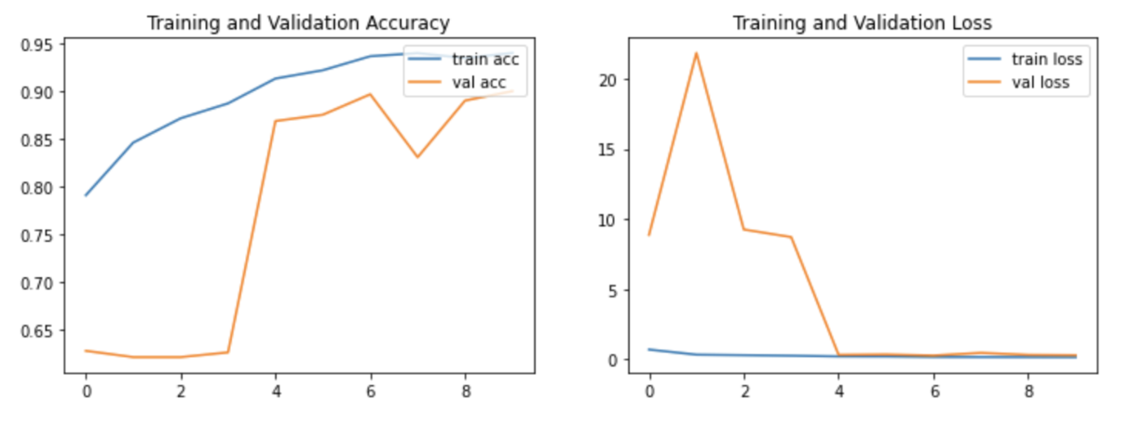
Evaluating the Model
Figure 3. Training History Plots

Slide 13
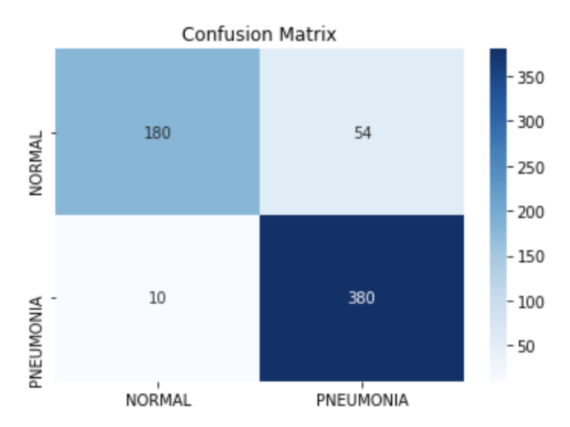
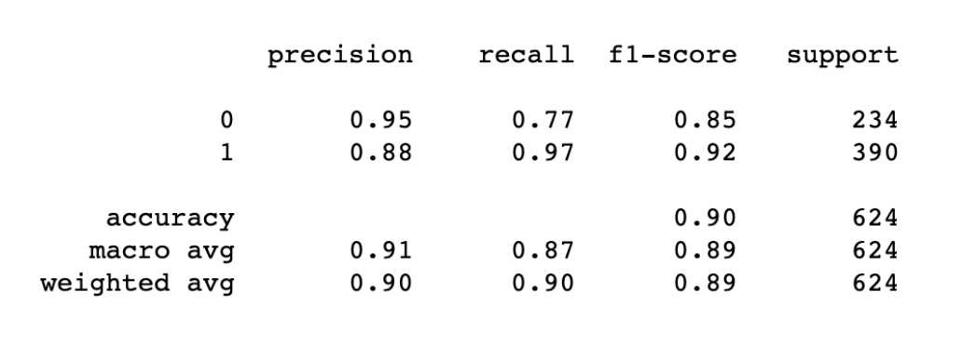
Model Performance
Overall accuracy on test data: 90% with 0.29 loss
Figure 4. Classification Report and Confusion Matrix

Slide 14
Summary of Results
Applied Deep Learning with CNN to classify chest x-ray images
Used Google Colab to apply the architecture (using Keras)
Developed a baseline CNN model with 90% accuracy
Four convolutional layers (max-pooling, batch normalization)
Four dense layers (drop out layers, sigmoid function)

Slide 15
Follow-on Work
Improve model accuracy with different approaches
Increase the number of convolutional layers
Change predetermined values (batch size, epochs, callbacks…)
Increase the number of data using
Data augmentation
Generative Adversarial Networks
Train the data using ‘Transfer Learning’ techniques

Slide 16
Thank you!
Meral BALIK
E-mail : tekmer@hotmail.com
Linkedin : www.linkedin.com/in/meralbalik
Project @ https://github.com/Meralbalik/Capstone-Project-2

